Slide 1
Number Bases and Binary Numbers, continued…

Slide 2
Bases above 10
So far we’ve discussed bases 10 and below
We can also have bases larger than 10 – this just means that there are more than 10 digits!
We use letters of the alphabet to represent digits beyond 9
Example: Counting in base 16 (hexadecimal) involves 16 possible digits (0-9, followed by A, B, C, D, E, F) 0, 1, 2, 3, 4, 5, 6, 7, 8, 9, A, B, C, D, E, F, 10, 11, 12, 13, 14, 15, 16, 17, 18, 19, 1A, 1B, 1C, 1D, 1E, 1F, 20, 21, …

Slide 3
Counting in bases 10, 2, and 16
Dec | Bin | Hex | Dec | Bin | Hex
0 | 0 | 0 | 8 | 1000 | 8
1 | 1 | 1 | 9 | 1001 | 9
2 | 10 | 2 | 10 | 1010 | A
3 | 11 | 3 | 11 | 1011 | B
4 | 100 | 4 | 12 | 1100 | C
5 | 101 | 5 | 13 | 1101 | D
6 | 110 | 6 | 14 | 1110 | E
7 | 111 | 7 | 15 | 1111 | F

Slide 4
Converting bases larger than 10 into base 10
Same algorithm as before, but letters must be replaced with their base 10 number equivalents (A = 10, B = 11, C = 12, etc.)
Example: Convert (3AF)₁₆ to base 10. Here, each digit represents a power of 16:
(3AF)₁₆ = F x 16⁰ + A x 16¹ + 3 x 16²
= 15 x 16⁰ + 10 x 16¹ + 3 x 16²
= 15 + 160 + 768
= 943
(3AF)₁₆
=
(943)₁₀

Slide 5
Converting base 10 into bases larger than 10
Same algorithm as before, but remainders over 9 must be replaced with their letter equivalents (10 = A, 11 = B, 12 = C, etc.)
Example: Convert (287)₁₀ into base 16
(287)₁₀
=
(11F)₁₆
287 / 16 = 17 R 15 (F)
17 / 16 = 1 R 1
1 / 16 = 0 R 1
Stop once you get a quotient of 0

Slide 6
Converting from any base into any other base
So far we've discussed:
Converting from other bases to base 10
Converting from base 10 to other bases
How would you convert from any base to any other base (e.g., base 3 to base 5)?
There is a shortcut we can use for converting between bases 2 and 16
Key idea: each digit in hexadecimal can be represented with four bits in binary

Slide 7
Converting from base 2 into base 16 (binary into hexadecimal)
Group the bits in sets of 4, starting from the rightmost bit
Each group of 4 bits corresponds to a single hexadecimal digit. You can look this up on the table in slide 3 (or make your own table!)
Example: Convert (10111010111)₂ into base 16 The rightmost 4 bits (0111) correspond to 7 in hex The next 4 bits (1101) correspond to D in hex The leftmost bits (101) correspond to 5 in hex
10111010111
(10111010111)₂
=
(5D7)₁₆
5
D
7

Slide 8
Converting from base 16 into base 2 (hexadecimal into binary)
Each hexadecimal digit corresponds to a group of 4 bits. Again, you can look this up on the table in slide 3, or make your own table!
CAUTION: We must add leading zeros if needed to ensure each hex digit corresponds to 4 bits. Leading zeros aren’t needed for the leftmost hex digit.
Example: Convert (1A3)₁₆ into base 2 The 3 in hex corresponds to the bits 0011 (we added two leading zeros here) The A in hex corresponds to the bits 1010 (no leading zeros needed, since this is already 4 bits) The 1 in hex corresponds to the bit 1 (no leading zeros needed, since this is the leftmost hex digit)
1
A
3
(1A3)₁₆
=
(110100011)₂
Leading zeros added here
110100011

Slide 9
Whew!
To recap, here’s what you should be familiar with by this point:
Converting numbers from any base into base 10
Converting numbers from base 10 into any base
Converting numbers between bases 2 and 16 using the shortcut
And now for some applications! Remember that computers use base 2 (binary) to represent everything:
Data (numbers, text, pictures, video, sound, etc.)
Programs (instructions on what to do with the data)

Slide 10
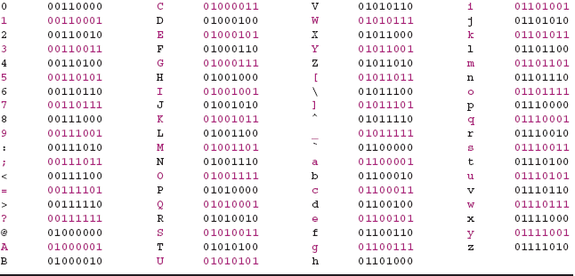
Representing characters with bits
ASCII – American Standard Code for Information Interchange (1963)
7-bit encoding scheme: Each character is represented by a unique set of 7 bits
2⁷ or 128 different possible characters (unique combinations of bits)

Slide 11
Representing colors with bits
Colors can be represented as a combination of red, green, and blue (RGB) components
A six-digit hexadecimal color code represents the contributions from each component, in base 16
Each component covers two base 16 digits (00-FF)
In base 10: 0-255
In base 2: 00000000-11111111 (8 bits per color)
Example: red 255, green 13, blue 154 (in base 10)
Red: (255)₁₀ = (11111111)₂ = (FF)₁₆
Green: (13)₁₀ = (00001101)₂ = (0D)₁₆
Blue: (154)₁₀ = (10011010)₂ = (9A)₁₆
Color code:
#FF0D9A

Slide 12
Representing other things with bits
Pictures
A picture is just a rectangular grid of pixels, each one of which is a certain color
Video
A video is simply a sequence of pictures!
Sound
Sound in the real world can be represented as an analog (continuously varying) signal
To store in a computer: convert the analog signal to a digital form (e.g., using pulse code modulation)
This represents the sound as a sequence of 0’s and 1’s
When the computer plays back the sound, it takes the digital form and converts it back to analog

